Slide 1
Empowering EQUO:
A data-driven future
Notes:
CD

Slide 2
Introduction
CIYK_INSIGHTS
4
5 - 6
7 - 12
13 - 14
20XX
Business Questions
KPIs & KRIs
Missing Data & Data Quality
Data Strategy & ESG
3 Questions & Visualisations
Notes:
CD
Today we are going to address:
Three business questions. These have all used data analysis, performed in BigQuery, to underpin the visuals which we put together in Looker Studio.
Each question will address Key Revenue Indicators and Key Performance Indicators.
We will examine how Machine Learning can be used and relate this to each of our business questions before highlighting Missing Data and Data Quality concerns.
Finally we will consider your Data Strategy and Environmental, Social and Governance considerations.

Slide 3

BUSINESS QUESTIONS
What location should Alex open the shop in?
What is the return rate per product category?
What marketing Campaign is the main source of orders and revenue?
Notes:
CD
Our first question relates to Alex’s objective to open a new store….
The business objective relates to Ameinas objectives to improve product quality is supported by assessing the return rate per product
The business objective to increase revenue by 50% by the end of the second half of the year is supported by understanding the source of orders and revenue
Now we are going to take a look at Key Revenue Indicators and Key Performance Indicators

Slide 4

KPIs
KRIs
The percentage of returned items should be less than 20%.
Implement a customer sentiment analysis with ML to reach a 90% customer satisfaction.
Increase revenue from Social Campaigns by 20% by end of year and increase revenue from email campaigns by 30% by end of year.
Return rate is reduced by 10%.
Percentage increase in customer satisfaction scores which drives revenue.
Increase revenue generated by Marketing campaigns by 50% by end of H2.
Notes:
Hi everyone, good afternoon I hope everyone is doing well my name is I am Isaiah and today im going to speak about our kpis and kris
Define KPIs:
To start off for those who don’t know what a kpi and a kri is let me explain a kpi is short for Key Performance Indicators which measures ongoing performance and progress towards specific goals, while kri which is short for Key Result Indicators (KRIs) reflect the outcomes of those efforts and the overall success achieved.
1)For the first kpi The percentage of returned items should be less than 20%. Your returned rate is 21.8% and the solution on how you could fix this is to efficiently manage your inventory, directly impacting sales performance, which could help with better cost management, and cash flow. Which will resulting in your return rates reducing by 10%. This is Kojo’s objective.
2) And for your second kpi which is to Implement a customer sentiment analysis with ML to reach a 90% customer satisfaction. As we don’t have customer satisfaction data you can implement a sentiment analysis with Machine Learning by the end of the year and this KPI measures the overall quality of the clothing items based on customer feedback. Also another way would be to use a sentiment analysis is to build a survey based on customer satisfaction with a metric of 7/10 score customer satisfaction. This should have a percentage increase in customer satisfaction scores which drives revenue. This is Ameena’s Objective
Now I will pass it on to Yousuf who will talk about his business question.

Slide 5
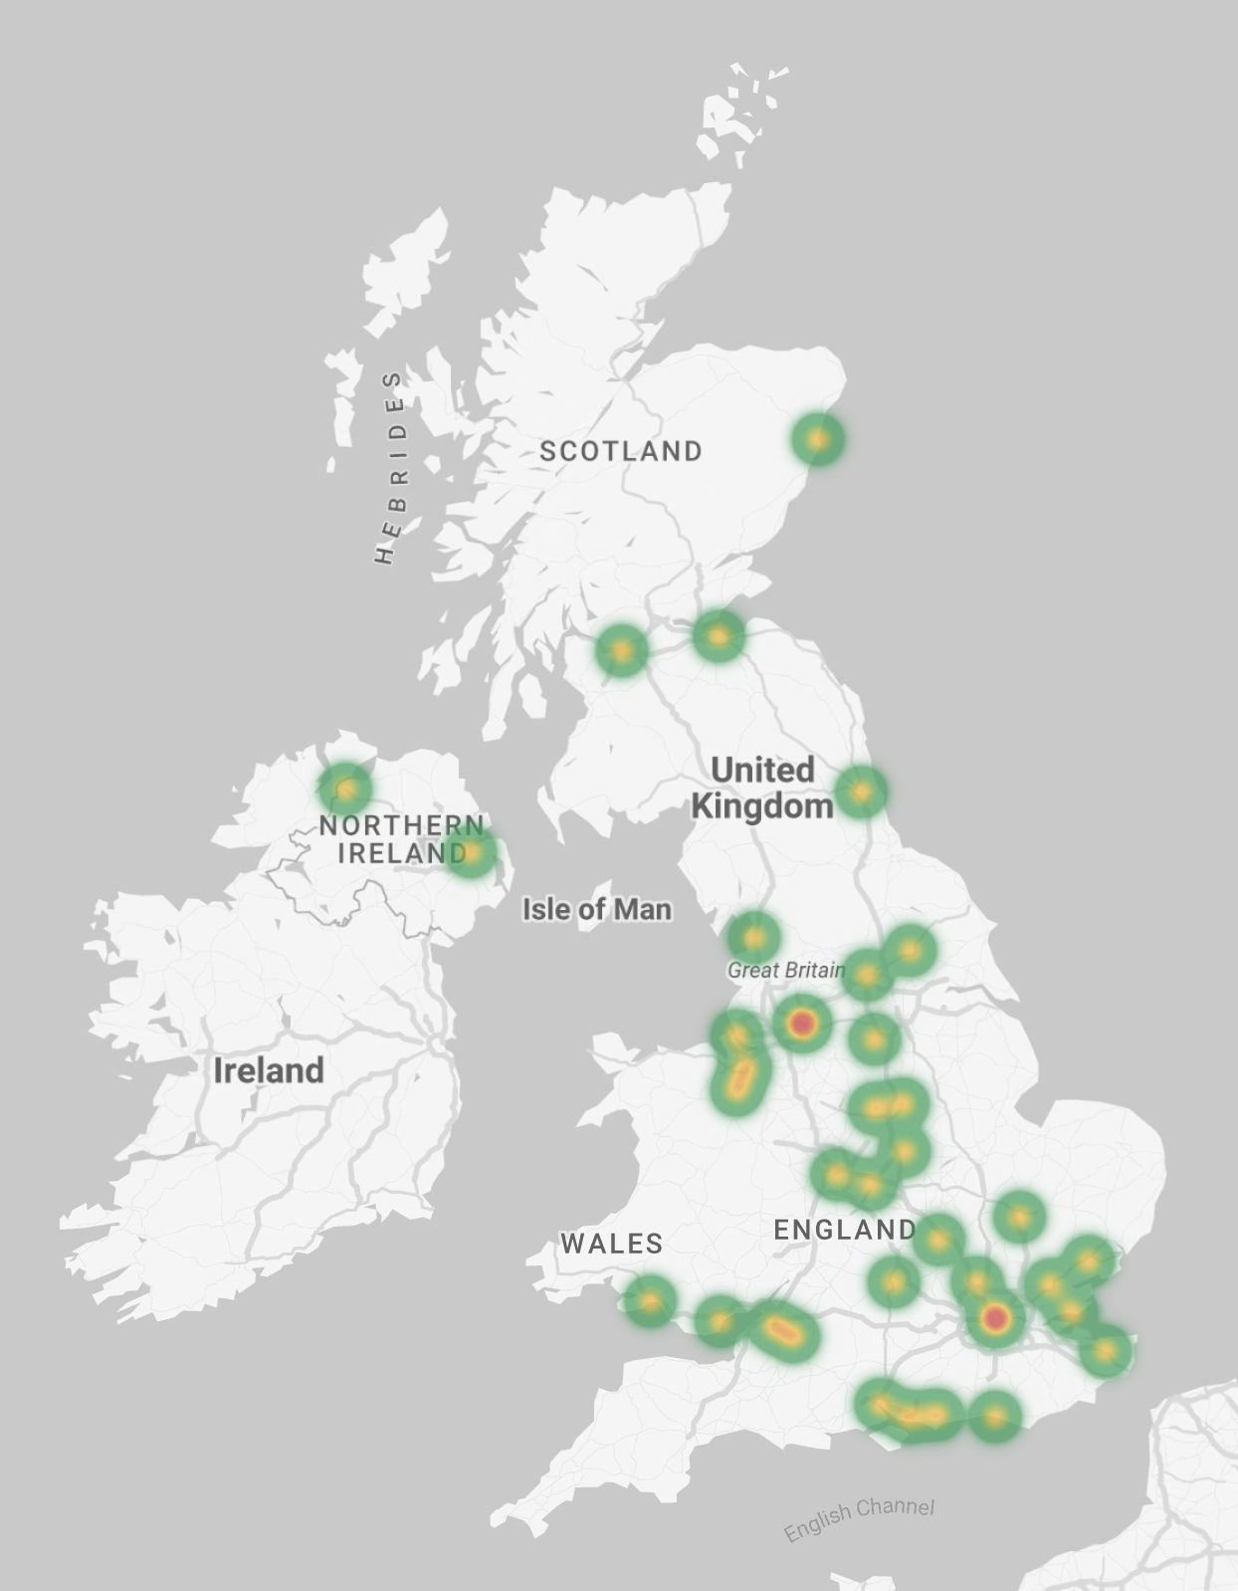
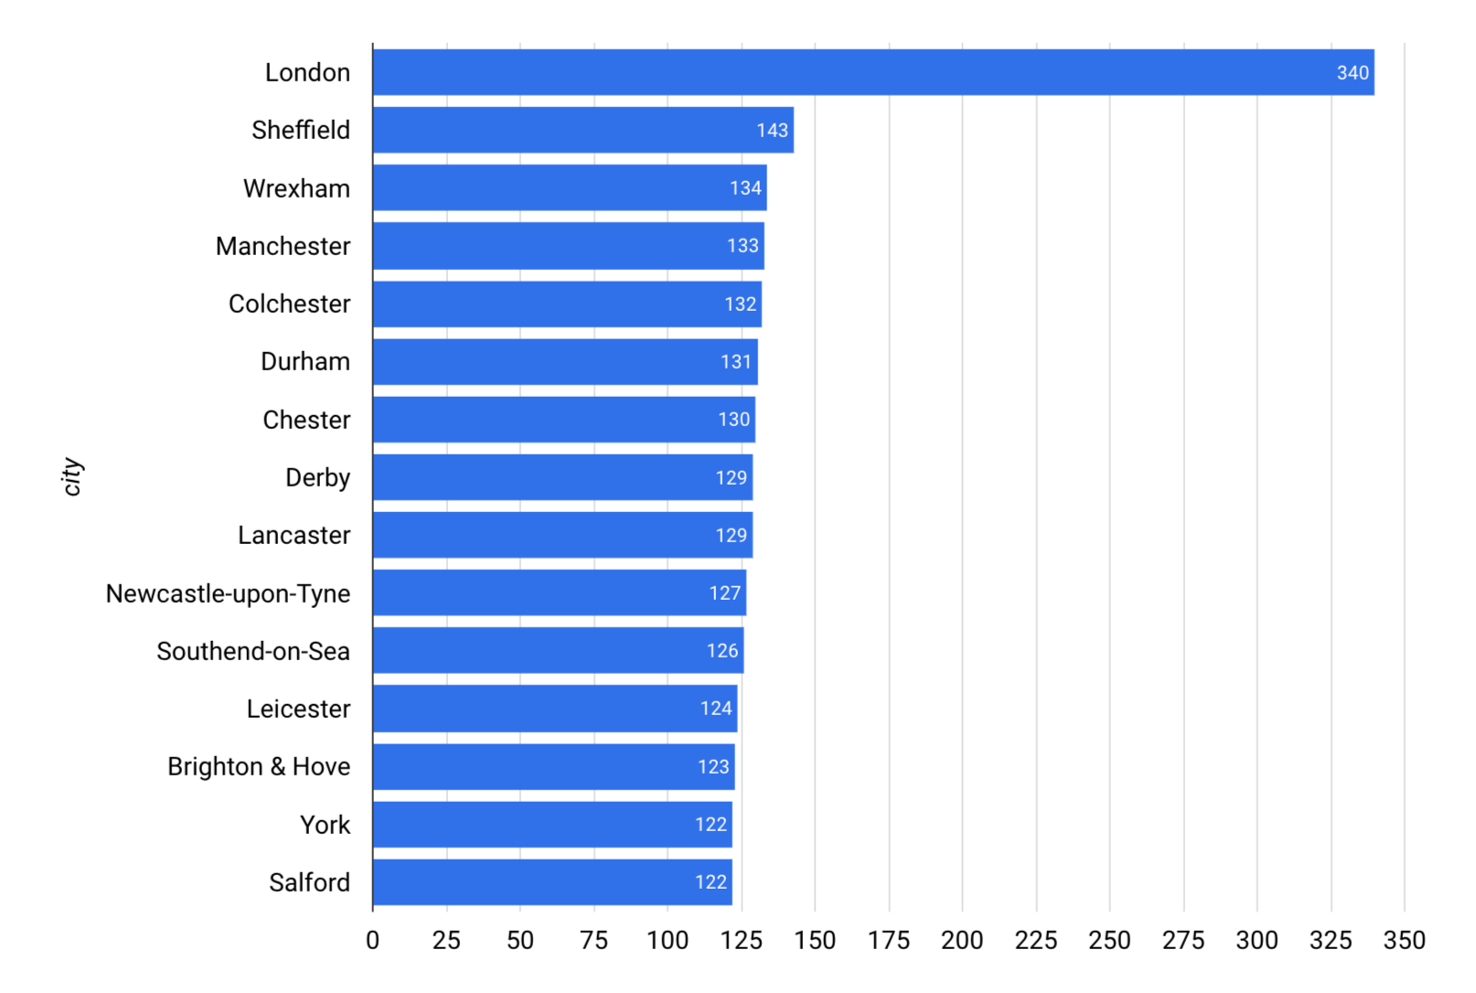
What location should EQUO open a physical store in?
Majority of EQUO customers are based in London
Heatmap of customers by city
number of customers
Visualisations made in Looker Studio
Notes:
YK
The first business question we decided to focus on was “What location in the UK would be best to open a physical store for EQUO?”.
On the left, we have a bar chart which tells us that the majority of our customers are based in London. This makes London an excellent place to open our shop.
However, if we look closely at the heatmap on the right, we see another red spot that isn’t London.
This happens because two locations Manchester and Salford are being grouped together. Combined, this area accounts for 255 customers. If we include other areas in central England, such as Sheffield, the data suggests that opening a store near Manchester could also be a viable option.
That being said, we should consider the drawbacks of both locations. The general footfall for shops in Manchester would be less than that of those in London. But the rent in London will probably be higher than that in Manchester making Manchester more cost-effective.
Because the cluster of customers near London is larger than that in central England, we would suggest that a store should be opened in London.
I mentioned footfall and rent which leads me onto some data quality issues and missing data that may be useful for us to make a decision.
If we had data about the rent of opening a shop in different locations, the footfall in both locations and more customer demographic data (maybe like age and income), this would be useful data for us.
Also, after doing some exploratory data analysis in our customers data, we found that some customers signed up with the same email in different locations for whatever reason. This is a data quality issue as it skews our results a bit.
(Footfall is the number of people entering an area, shop or building in a given time.)

Slide 6

Using machine learning to find a location for opening the shop
Linear regression - can be used to model the relationship between shop rent prices (dependent variable) and one or more independent variables (like location, foot traffic).
K-means clustering - can be used to identify areas with high potential based on demographic data, customer behavior, and competitor locations.
Notes:
YK
One model we can use is linear regression and this can be used to model the relationship between rent prices (y-axis) and an independent variable like location and foot traffic. This model can help us identify locations that offer the best balance between affordability and high customer traffic.
K-means clustering will help us identify optimal locations by grouping areas with similar characteristics. We’ll cluster based on demographic data (for example, income levels, population density), customer behavior (for example., spending patterns), and competitor locations. This result will allow us to pick a location, avoiding regions with saturated markets and focusing on areas with high customer demand and favorable competitive conditions.

Slide 7
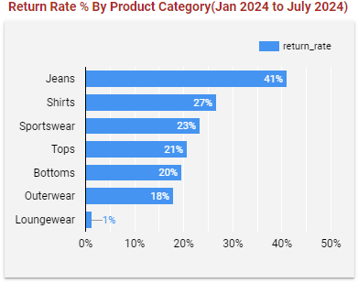
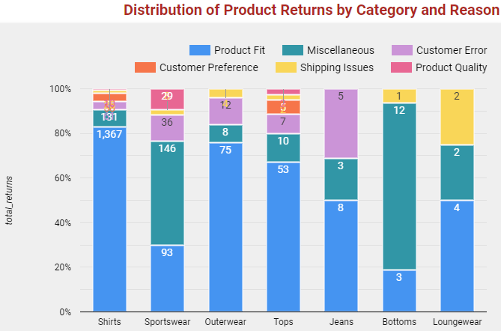
What product category gets returned the most & the top reason for returns?
The return rate for loungewear(1%) and outerwear(18%) are relatively low, indicating high customer satisfaction and product quality.
By removing the outlier i.e; Jeans & Loungewear, we get the average return rate is 21.8% which is not bad for fashion business.
‘Product fit’ is identified as the primary reason for returns.
LookerStudio Chart1
LookerStudio Chart2
Notes:
KB
Outerwear and Loungewear are relatively low return rate, 18% and 1% respectively, which shows customer satisfaction and product quality.
Although Jeans has the highest return rate, Jeans also has the lowest total bought. Jeans is an outlier which is not representative of the average returns rate. The same can be said of Loungewear, so we have removed these and averaged the remaining categories to get an average return rate of 21.8%. This does not appear to be bad for a fashion business.
Since we want to both improve the customer experience and double revenue in H2 we should consider our outlier, Jeans and use surveys and reviews to assess why the return rate is so high. By tackling this issue we could see an increase in Jeans sales and a reduction in returns.
Let’s move on to the next chart on right side, which is Distribution of Product returns by category and reason. As we can observe, the primary reason for returns is product fit. Notably, the shirt category has the highest number of returned items, that is around 1.3k, indicating that fit issues are particularly common in this category …. but its sales volume has been very high. Again, in outwear category which has 75% returned items shows the product fit issue.

Slide 8
Using Machine Learning to reduce returns
To Predict Return Likelihood and Return Reasons
Analyse customer reviews using Sentiment Analysis ( NLP techniques such as BERT, GPT-3).
Predicting Return Probability using Logistic Regression.
Recommended score: Precision, Recall, and F1 Score.
Notes:
KB
1. We can use Sentiment analysis which uses NLP techniques to determine the emotional tone of customer reviews. By applying models like BERT and GPT-3, we can accurately classify reviews as positive, negative, or neutral. This helps in understanding customer dissatisfaction and pinpointing specific product issues. For example, BERT can analyse the context of words in reviews, providing a nuanced understanding of customer feedback.
2.To predict the likelihood of returns, we can use logistic regression. This statistical model helps us estimate the probability of a return based on input features such as customer reviews, product ratings, and purchase history. By training the logistic regression model on historical data, we can identify key factors contributing to returns.
3. Then score(s) we would recommend : Precision, Recall, and F1 Score: Important for understanding the model's performance in identifying positive and negative sentiments correctly.

Slide 9
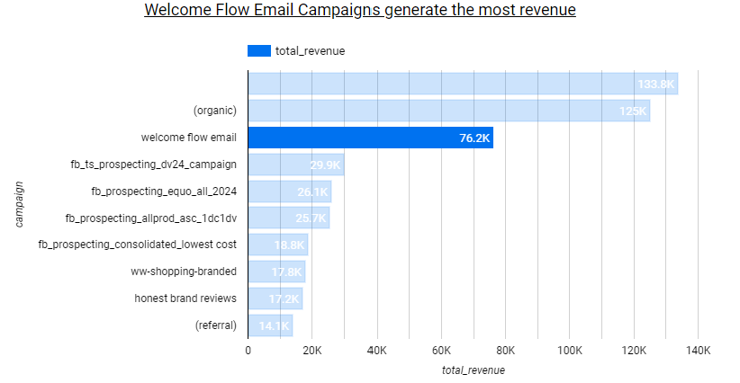
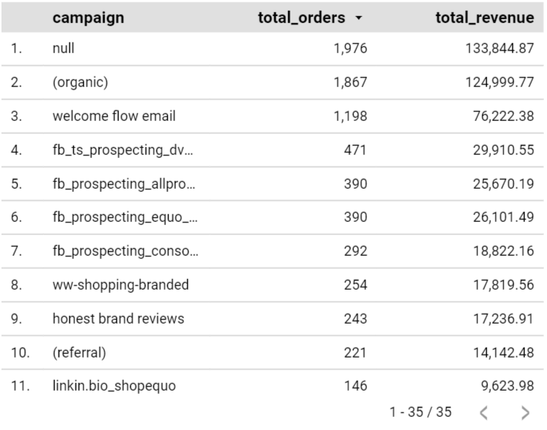
What Marketing Campaign generates the most orders and revenue?
Welcome Flow email generated the most orders & Revenue after Organic.
Facebook appears to be the only Social Channel being used in Marketing campaigns.
Created using Looker Studio
Notes:
CD
This slide supports a KRI which is how can we increase revenue by 50% in H2 and is focused on providing actionable insights to Jared that will help the work you are doing putting together a marketing strategy for EQUO.
As we consider where orders and revenue come from we can start to put together KPIs for your marketing team:
Jared you will know this already but for the rest of the team, Marketing campaigns can be divided into two main categories: organic and paid. Organic campaigns use non-paid methods to drive traffic to your website and account for the majority of orders and revenue. The team’s efforts in SEO, blogs, and other content strategies have significantly boosted organic search results. While these efforts should certainly continue, we will focus on identifying which paid marketing channel has generated the most orders and revenue.
The most successful paid campaign was the Welcome Flow email, as highlighted in the chart. This campaign resulted in nearly 1,200 orders and £76,000 in revenue.
It is important to note that there is an issue with the data: £133,800 in revenue is attributed to 'null' campaigns, meaning this revenue cannot be linked to any specific campaign. Moving forward, a KPI for Jared could be to ensure all revenue is attributed to a tagged campaign as this would enable a more comprehensive assessment of revenue sources.
Looking at the campaign table, we can see that Facebook is currently the only social channel being utilised for marketing. Without data from Instagram and TikTok, we cannot determine the potential performance of these channels. Considering your target audience, it may be beneficial to conduct A/B testing on Instagram and TikTok campaigns to explore potential revenue increases through these platforms. Consequently a saecond KPI would be to A/B test campaigns on Instagram and Ticktok as well as Facebook, to expand social engagement.

Slide 10
Using Machine Learning to support the Marketing team
Customer Segmentation using clustering (K-means).
Identify potential customers based off existing customer profiles using supervised learning (Lookalike Modelling).
Improve revenue forecasting using Classification Algorithms e.g. Random Forest.
Improve marketing channel performance by better understand marketing touchpoints and the customer journey using Multi-Touch Attribution (Markov Chains).
Notes:
CD
Sentiment Analysis: Natural Language Processing (NLP) can be used to analyse customer reviews and social media mentions, allowing EQUO to gain insights into sentiment towards the brand and products. This supports marketing by informing marketing strategies and product development.
Customer Segmentation: Clustering Algorithms (e.g., K-Means) can be used to segment customers into distinct groups based on purchasing behaviour, demographics, and preferences. This helps tailor marketing strategies and product offerings to different customer segments.
Lookalike Modelling: Supervised Learning Algorithms can be used to identify potential customers who resemble high-value existing customers, enabling the expansion of campaigns to similar audiences likely to convert.
Churn Prediction: Classification Algorithms (e.g., Random Forest, Neural Networks) can be deployed to identify customers who are likely to disengage after a campaign and implement retargeting strategies to retain them, increasing customer retention and lifetime value.
Multi-Touch Attribution: Markov Chains could be deployed to better understand the contribution of each marketing touchpoint in the customer journey, providing a more accurate picture of how different channels and campaigns drive conversions and allowing the marketing team to focus spend.

Slide 11

Missing Data Issues
Product Reviews and Ratings: Valuable insights missing for product improvements.
Return reason: Return reasons are not specified properly.
Customer demographics: Lack of detailed customer profiles limits personalisation.
Geographic Data: Understanding regional preferences and shipping challenges.
Notes:
YK
We have already talked about some issues we had because we didn’t have certain data, but I will very quickly summarise some of those.
Currently, we have no data about product ratings so we have no idea what customers think of our products and we can’t make product improvements.
Similar to that, the return reason isn’t complete for a lot of returns, so we don’t know why customers are returning products. Is it because of product quality? That data might be useful for Ameena. Or is it because they ordered the wrong size? That will tell us our sizing chart is wrong.
Again, lack of customer demographic data means we have limited personalisation, whether that be product recommendations or ads.
And finally because we don’t have much geographic data, so this makes it difficult to understand regional trends and any shipping challenges we may have.

Slide 12

Data Quality Issues
Product Reviews and Ratings: If Equo lacks a good system for collecting and analysing customer reviews and ratings, valuable insights for product improvements may be missing.
Marketing: Lots of un-attributed revenue to marketing campaign.
Revenue: We know the sale price (incorrectly referenced in the data as the cost price) and quantity sold but not the cost of making each product line. We therefore can’t work out the profit margin being made.
Notes:
KB
Data quality issues, such as incomplete or incorrect information, can lead to inaccurate analyses and misguided business decisions.
So here In terms of Product Reviews and Ratings, we have faced incomplete data issue.
In marketing , there are lots of un-attributed to marketing campaign, source and medium has been given. When you have lots of unattributed revenue to a marketing campaign, it means that a significant portion of the revenue generated by your business cannot be directly linked or traced back to specific marketing efforts. In other words, while you see an increase in revenue, you can't clearly determine which marketing campaigns or activities were responsible for driving that increase.
With the Revenue data, we know the sale price incorrectly referenced in the data as the cost price and quantity sold but not the cost of making each product line. That’s why we could not work on profit margin

Slide 13
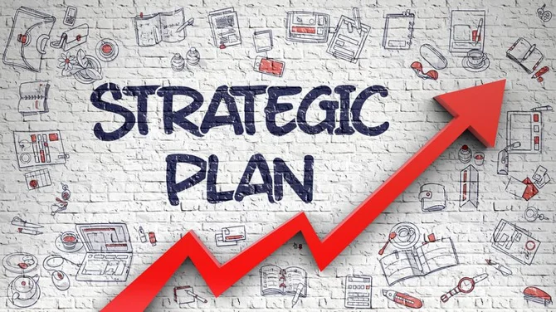
Data Strategy
Have a Vision
Leverage data-driven insights
Enhance product quality
Optimise marketing efforts
Build a sustainable, Customer-driven business.
Analytics and Insights
Utilise Jared’s expertise in SEO and Paid Marketing.
Customer attraction methods
conversion rates.
Campaign effectiveness.
Data Points & Richness
Collect detailed customer data.
Collect product data.
Technology
Use advanced analytics tools.
Visualise data and generate actionable insights.
Process and governance
Data Protection / GDPR
Governance around the use of ML / AI.
Notes:
IG
Define Data Strategy
To explain a little a bit about what a data strategy is data strategy is a plan that outlines the technology, processes, people, and rules required to manage, analyse, and utilise an organisation’s data to support its business objectives. Here are some examples you should implement into your business for a plan for your data strategy.
Now I will pass it over to Yousuf and he will give you some more examples.
Why is a Data Strategy important?
Technology: Google Analytics, BigQuery, Looker Studio or Tableau or Power BI to visualise data to generate actionable insights
Staff / Suppliers: Collect and analyse data from suppliers to optimise the supply chain and ensure timely deliveries.
Leverage data-driven insights to enhance product quality, optimise marketing efforts, streamline operations, and build a sustainable, Customer-driven business.
Utilise Jared’s expertise in SEO and Paid Marketing to analyse Customer attraction methods, conversion rates, and campaign effectiveness.
Collect detailed customer data, including demographics, purchase history, and preferences.
Product Data: Maintain comprehensive data on product performance, including sales, returns, and customer reviews.
Use advanced analytics tools to visualise data and generate actionable insights.
Integrate strong data protection measures and General Data Protection Regulations compliance protocols into our AI/ML governance framework, ensuring transparency, accountability, and the ethical use of data throughout the lifecycle of AI/ML systems.
Compliance protocols refer to the set of rules, procedures, and guidelines that an organization follows to ensure it adheres to legal and regulatory requirements. In the context of Data Protection and GDPR, these protocols might include:
Data Handling Procedures: Guidelines on how to collect, store, process, and share personal data.

Slide 14

Data Strategy
Customers and citizens
Enhance customer experience
Customer data privacy protection
User-generated content analysis
Predictive customer support
Staff and suppliers
Staff training and development
Supplier chain optimisation
Employee engagement
ESG (Environmental social governance)
Track and report on sustainability metrics such as carbon footprint, waste reduction, and ethical sourcing of our clothing materials
Build trust in data
Data transparency
Clear data policy on the website
Ethical data practices
Regular data audits
Notes:
YK
The data strategy regarding customers and citizens:
We can use data to understand and enhance the customer experience, offering personalised recommendations based on past purchases
Customer data privacy protection: Implement strict data privacy measures to protect customer information and build trust with our customers
User-generated content analysis: Like mentioned earlier, we can leverage reviews, ratings, and social media posts from our customers to understand customer sentiment
Predictive customer support: By this I mean we could Introduce an AI chatbot on our website to handle common customer inquiries and issues, so we are using predictive analytics to address potential concerns and this results a smoother customer experience.
Moving on to staff and suppliers:
Provide training for staff on data literacy and the use of analytical tools, so that everyone understands the importance of data in decision-making.
Regarding the supplier chain, we can use data to monitor and evaluate supplier performance, so we can ensure quality and efficiency of the supply chain.
Data can also be used to assess and improve employee satisfaction and productivity. I understand EQUO is a relatively small company right now but this could be useful later on.
Environmental Social Governance (ESG for short):
We will talk about ESG in more detail later but our data strategy regarding this would be to track and report on sustainability metrics such as carbon footprint, waste reduction, and ethical sourcing.
Last but not least, we need to build trust in data:
We need to maintain transparency in how data is collected and used. This could be done through clearly having our data policy on our website.
Linking on from the last point we need to make sure the data is only used in ways that aligned in our policy, so we need to have ethical data practices
Finally we can conduct regular audits to ensure data integrity and accuracy

Slide 15
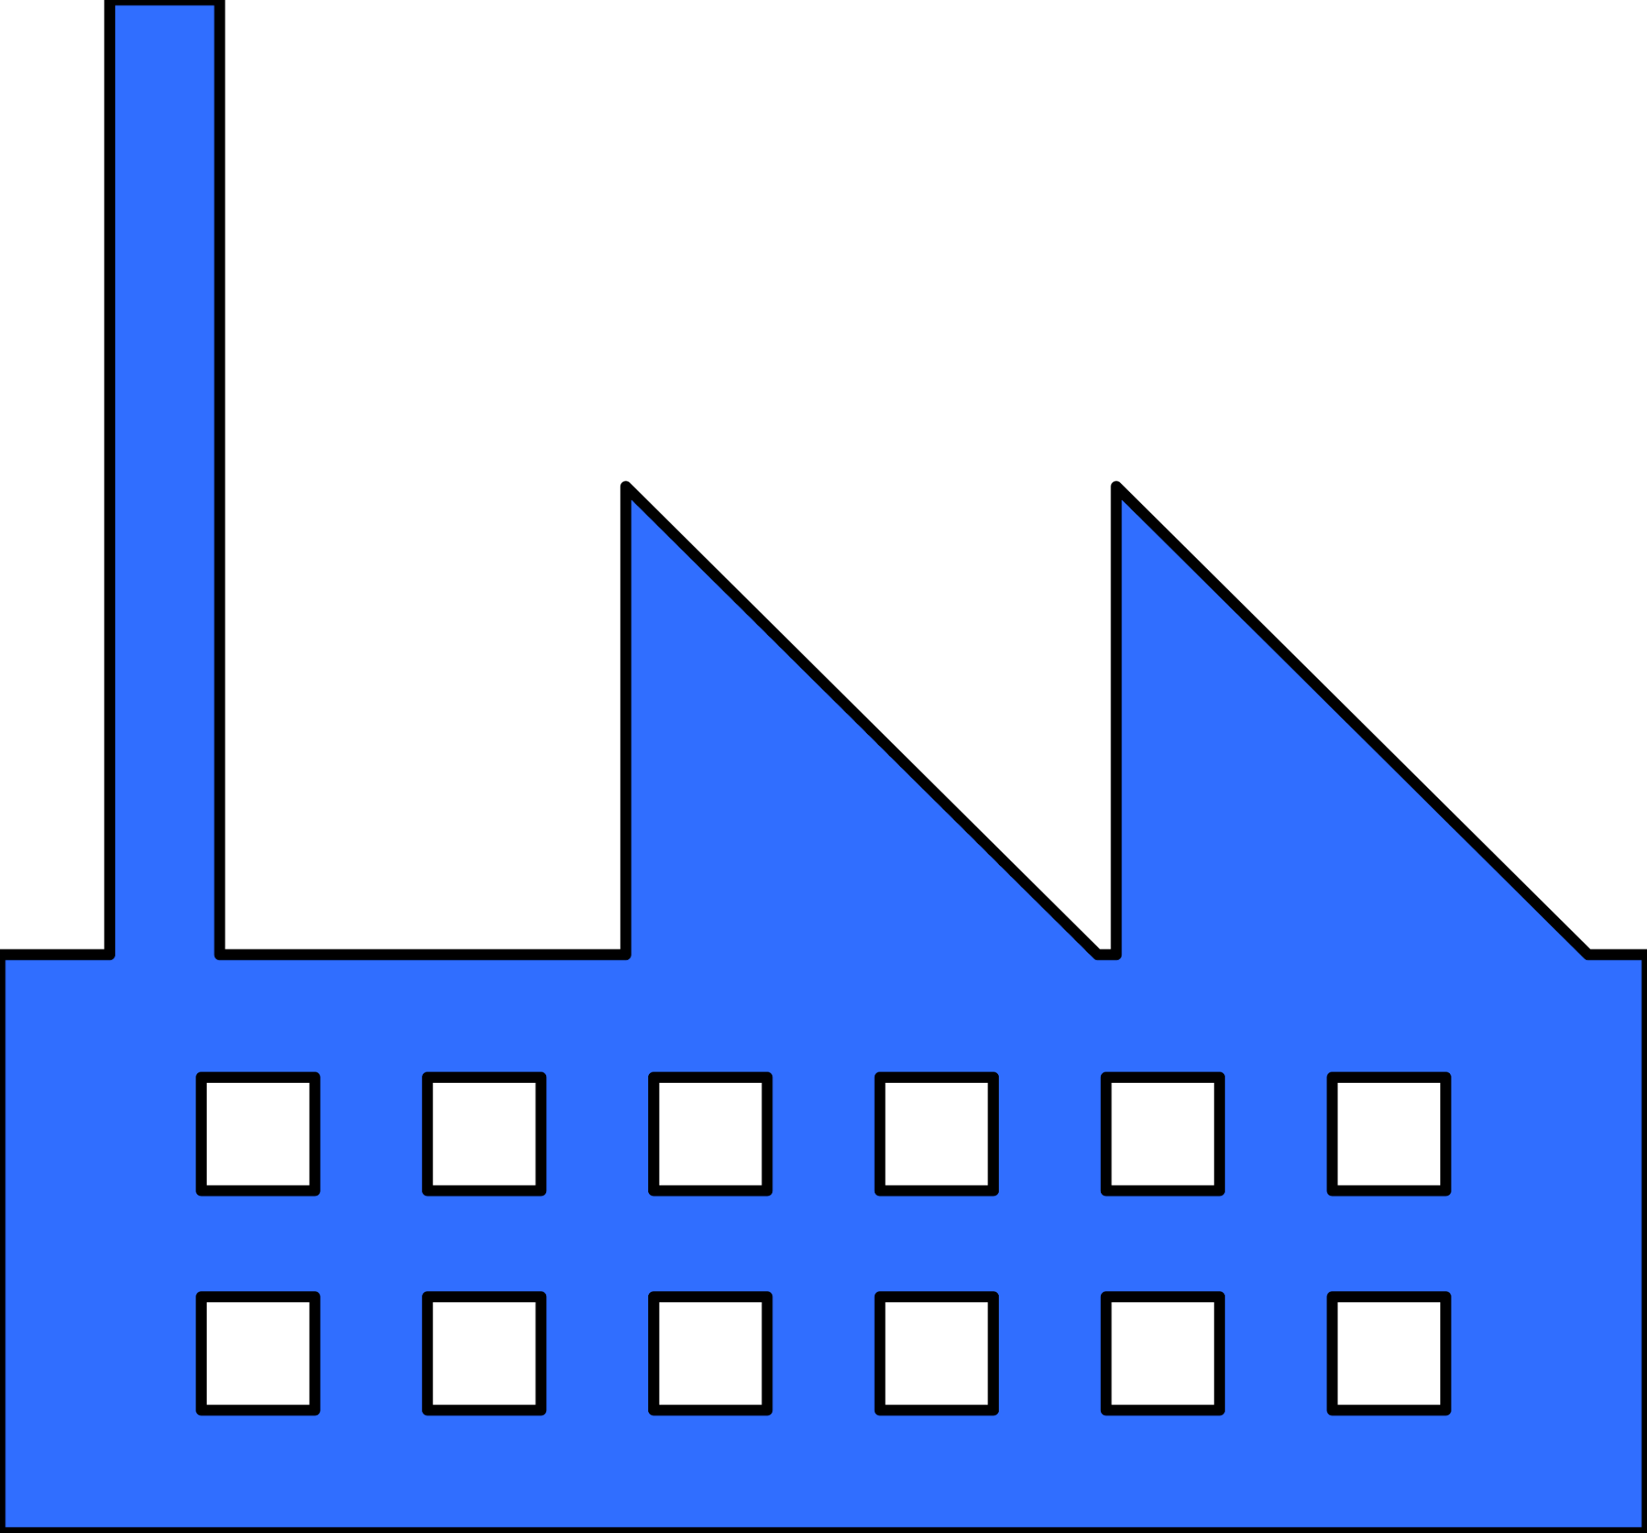








ESG
Environmental
Social
Governance
Notes:
CD
ESG stands for Environmental, Social and Governance and should be a core part of your business. It covers a lot so this is a high-level look at some ESG considerations.
The Environmental impact covers many areas of your business, from the water, materials and transportation of your products to the electricity and cooling needs of data centers. We could consider our service providers and their environmental policies. For example running a data centre uses a lot of water for cooling so the discharge of this water will have an environmental impact and should be well documented in their ESG policies, as should the amount of energy used in their data warehouse and where this comes from.
The Social impact could cover the conditions that those who make your clothes work in, the conditions of warehouse employees and more. There is an opportunity for the Social impact to demonstrate a high degree of caring. For example, by having an up to date modern-slavery policy you can dictate the conditions your manufacturers allow their workers to produce your clothes in. Having a Fair Trade Policy indicates you care about the pay of people throughout your supply chain and these could draw customers to your brand.
Governance is a crucial consideration as it ensures you are compliant with relevant laws. Given your global operations there are different laws you need to be aware of in areas such as data collection, data storage and data processing. This is covered in the UK by the Data Protection Act, in Europe by the General Data Protection Act (GDPR) and in the USA at state level. Being aware of your legal obligations when using data reduces your risk of financial penalties and the social fall-out that comes from the market losing trust in your company. Additional governance should be considered around the use of AI so that machine learning is used for good.
I am aware we have painted an onerous picture of ESG but being aware of your obligations is also an opportunity to remain innovative and at the forefront of best practices. Within Data this could cover using AI and Machine Learning. Rather than deploying ML without consideration, strong governance ensures people are aware how to use new technologies and what to use them for so they are deployed in a safe, ethical manner.
(maybe add bulletpoints in the slide)

Slide 16
Let’s summarise
Marketing
Operations
Product
KRI: Increase revenue by 50% in H2
KRI: Achieve 10% return rate or less by end of H2
KRI: Product quality score of 90%
KPI 1: Attribute all future revenue to a campaign.
KPI 2: Launch Instagram and Tiktok campaigns.
KPI 3: A/B test across social channels to determine which attracts the most new customers to the website.
KPI 4: Implement a sizing chart on the website.
KPI 5: Build AI model for customers to try on items before buying.
KPI 6: Percentage increase in customer satisfaction scores which drives revenue.
Notes:
We have covered a lot.
From identifying a location for your flagship store to identifying which products get returned and why through to the marketing campaigns which generate the greatest return on investment.
During the Analysis we defined three key KRIs. These are to Increase revenue by 50% in H2, to Achieve a 20% return rate of less by the end of the year (H2) and to achieve a product quality score of 90%.
These KRIs are supported by KPIs
KRIs
Jarred (Marketing): Increase revenue by 50% in H2
KPIs
Jarred: Attribute all future revenue to a marketing campaign.
Supports KRI to increase revenue by 50%
Jarred: A/B test marketing campaigns on Instagram and Ticktok as well as Facebook, to expand social engagement.
KRIs
Kojo: The percentage of returned items should be less than 10%.
Improvement of 11.8% from current return rate of 21.8%.
KPIs
Kojo: Implement a sizing chart on the website.
KRIs
Ameena: Percentage increase in customer satisfaction scores which drives revenue.
KPIs
Ameena: Implement a customer sentiment analysis with ML to reach a 95% customer satisfaction.

Slide 17


